Slide 1
“Tomato Harvesting using Machine Learning for Detection”
Project supervisor:
Er. Sagun Manandhar
Er. Pushpa Dhamala
Project by:
Mausam Gurung (KAT076BEI014)
Shalon Maharjan (KAT076BEI027)
Shubham Bista(KAT076BEI028)
Symon Shrestha(KAT076BEI029)

Slide 2

In Brief
Introduction
Problem statement
Objective
Scope and application
Component list
Block Diagram
Flowchart
Worrkdone

Slide 3
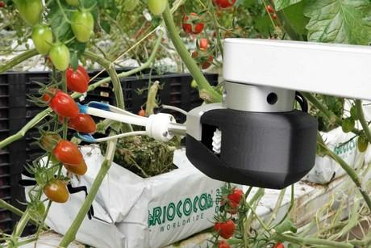
Introduction
This project excels at accurately moving the robot and its arm, identifying ripe tomatoes, and plucking ripe tomatoes without causing damage to the plant, which will lead to the human not engaging in such minor activities and focusing on larger issues.
“Tomato Harvesting using Machine Learning for Detection”

Slide 4
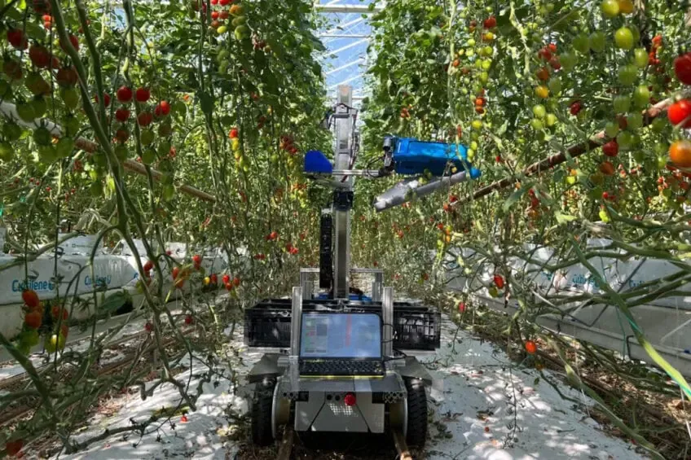
Introduction
1
Movement System
These robots use advanced control systems and motion planning algorithms for navigating uneven terrain and maneuvering efficiently around crops and obstacles. Their design focuses on reducing soil compaction to maintain soil health and ensures precise movement of its arms.
2
Harvesting Mechanism
The Harvesting Mechanism in this project is essential for gently and efficiently detaching ripe tomatoes from the plant to minimize damage and maintain crop quality. This robotic hand provides enhanced dexterity and versatility, enabling the robot to handle delicate tomatoes with precision and efficiency.
“Tomato Harvesting using Machine Learning for Detection”

Slide 5
Introduction
3
Recognition System
Machine learning-based Recognition System & advanced computer vision techniques
Employs Histograms of Oriented Gradients (HOG) features and a Support Vector Machine (SVM) classifier to identify and locate ripe fruits accurately.
Trains the ML-model on a vast dataset of tomato images
Helps in intelligently differentiate between ripe and unripe tomatoes, enhancing its harvesting capabilities.
“Tomato Harvesting using Machine Learning for Detection”

Slide 6
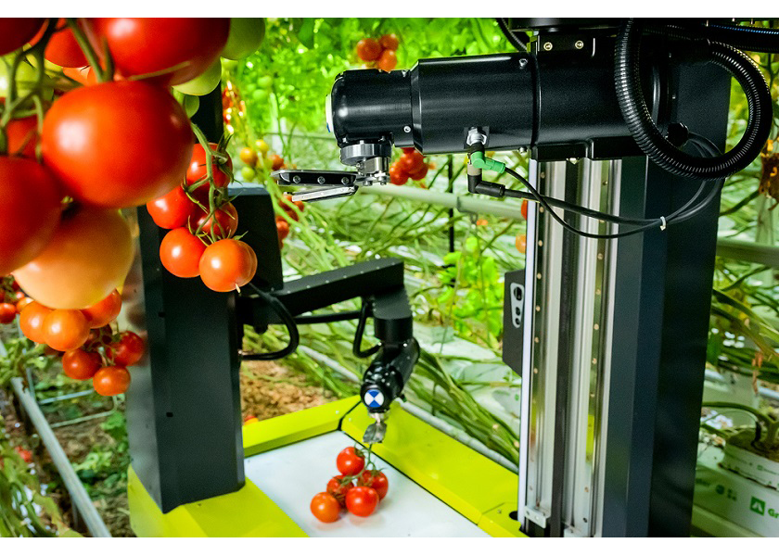
Problem statement
Traditional manual tomato harvesting is labor-intensive, costly, and inefficient, posing challenges to the agricultural sector. Identifying ripe tomatoes among foliage is difficult and can lead to crop damage and waste. To overcome these challenges, there's a critical need for an autonomous tomato harvesting robot with advanced recognition and precise harvesting abilities. This innovation aims to boost productivity, decrease labor reliance, and maintain high crop quality.
“Tomato Harvesting using Machine Learning for Detection”

Slide 7

Objectives
To develop an autonomous tomato harvesting robot with a 6DOF robotic hand and optimized movement capabilities
To Implement a machine learning-based Recognition System using HOG features and SVM classifier to accurately identify and locate ripe tomatoes.
“Tomato Harvesting using Machine Learning for Detection”

Slide 8
Scope and application of project
Revolutionize agricultural practices
Improve crop productivity and quality.
Adapting the autonomous harvesting robot for various greenhouse and field cultivation setups.
Enhancing sustainability in agriculture through the efficient use of resources and reduced environmental impact.
Potential application for other fruits and vegetables.
Improve labor shortages and production efficiency in the agricultural industry.
“Tomato Harvesting using Machine Learning for Detection”

Slide 9
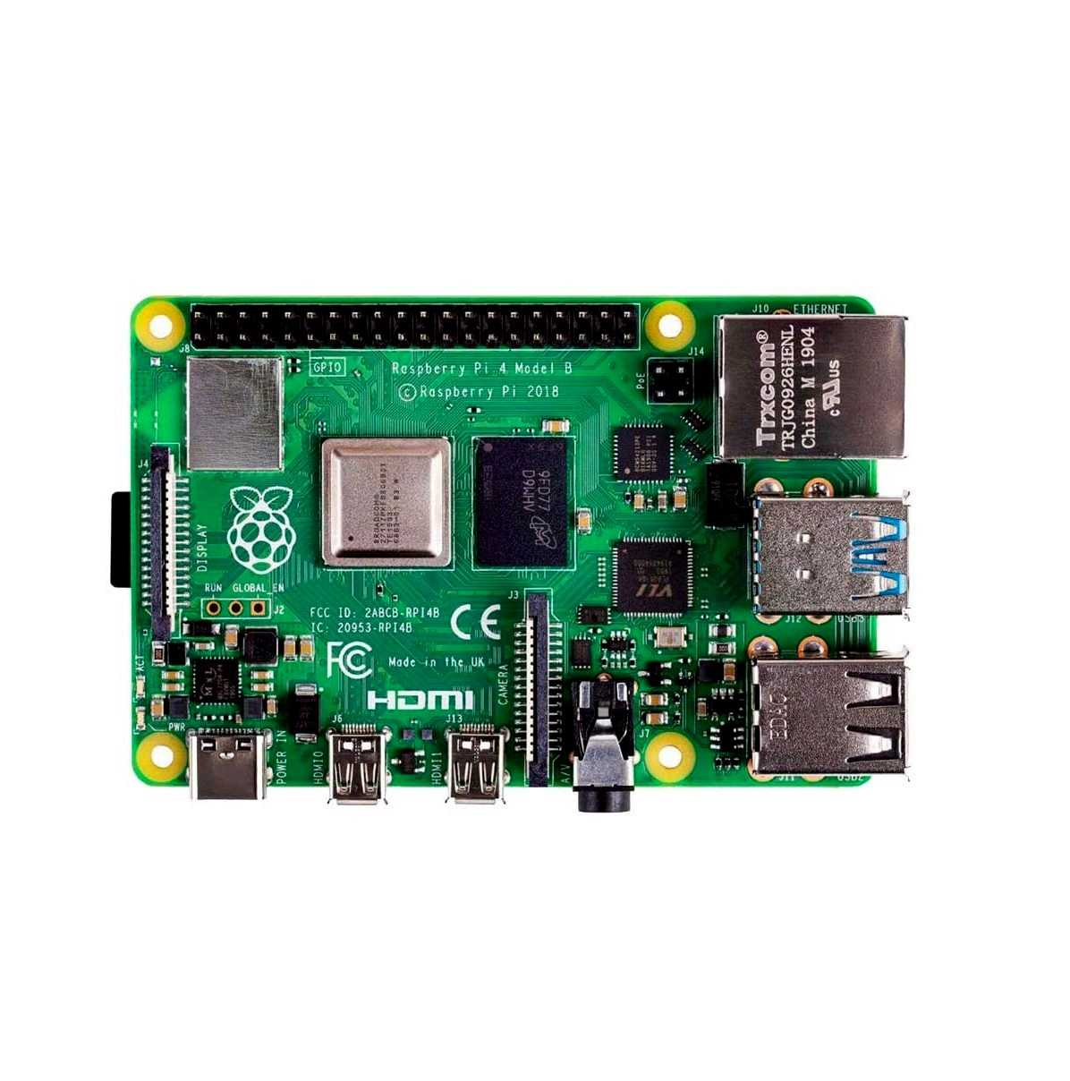
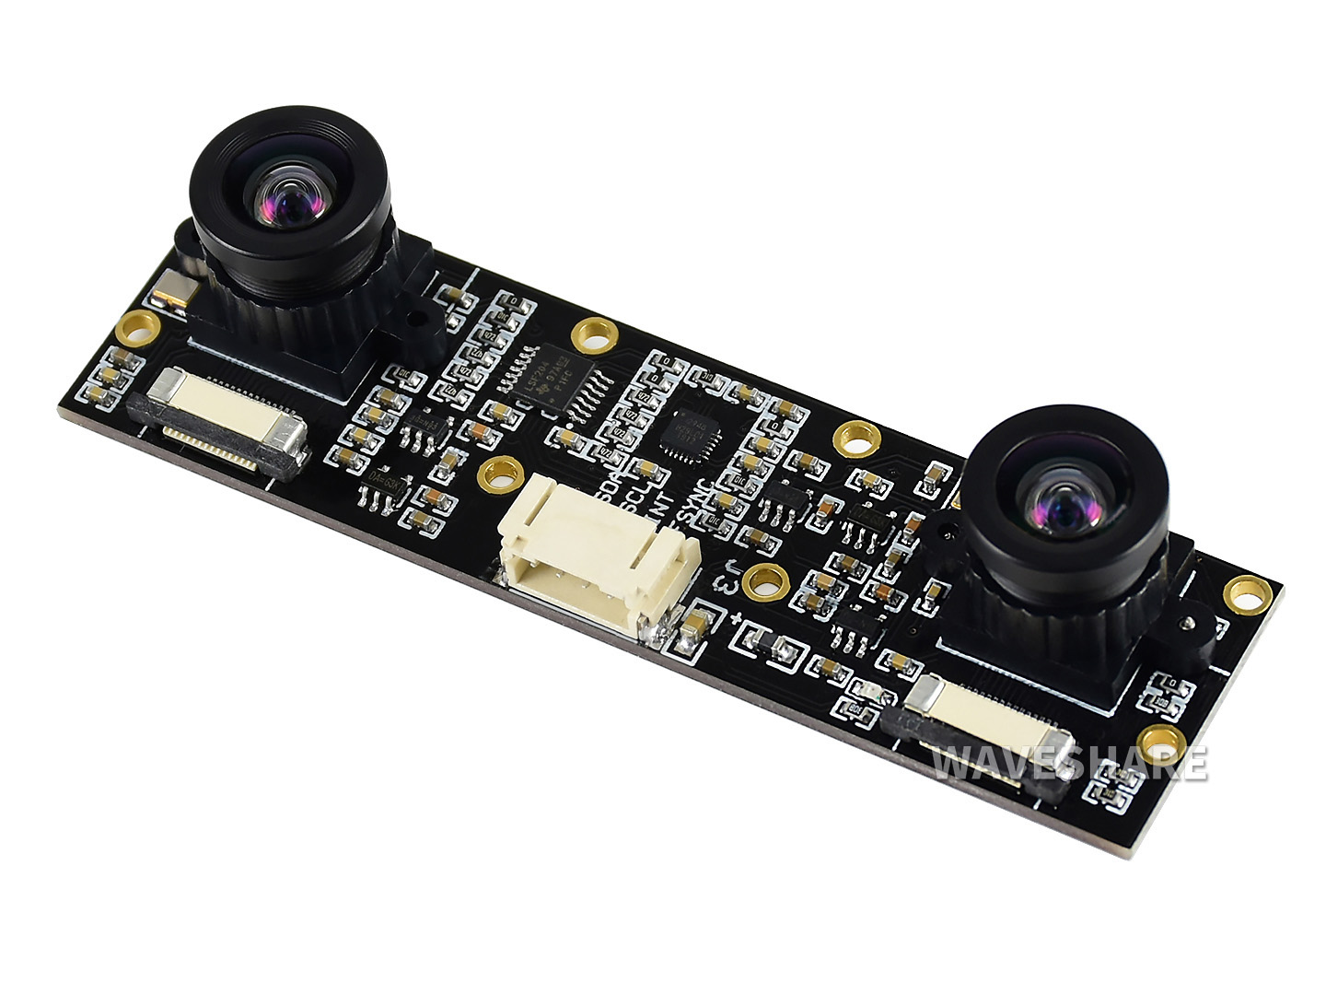
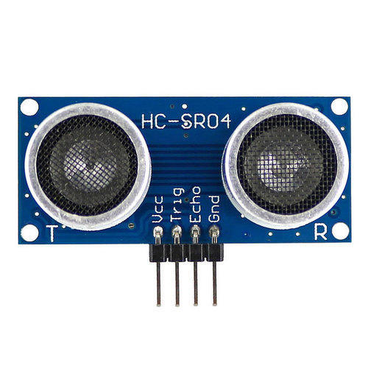
Component
IMX219-83 STEREO CAMERA, 8MP BINOCULAR CAMERA MODULE, DEPTH VISION
raspberry pi 4 model
HC-SR04 ultrasonic sensor
“Tomato Harvesting using Machine Learning for Detection”

Slide 10
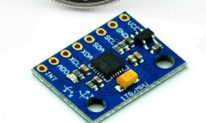
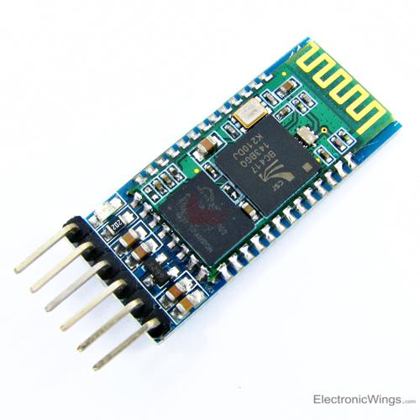
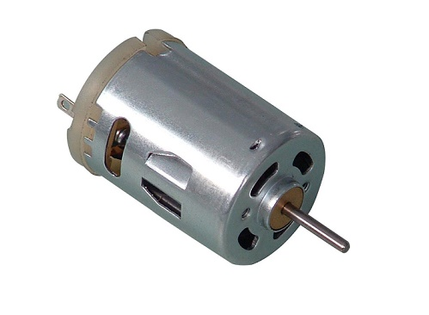
Component
TRIPLE AXIS ACCELEROMETER & GYRO MPU-6050
HC-05 Bluetooth
Driving DC motor
“Tomato Harvesting using Machine Learning for Detection”

Slide 11
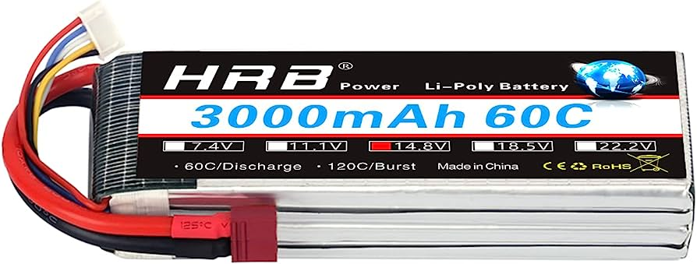
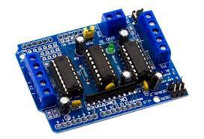
Component
L293D Dc motor Driver shield
Li-ion polymer battery
“Tomato Harvesting using Machine Learning for Detection”

Slide 12
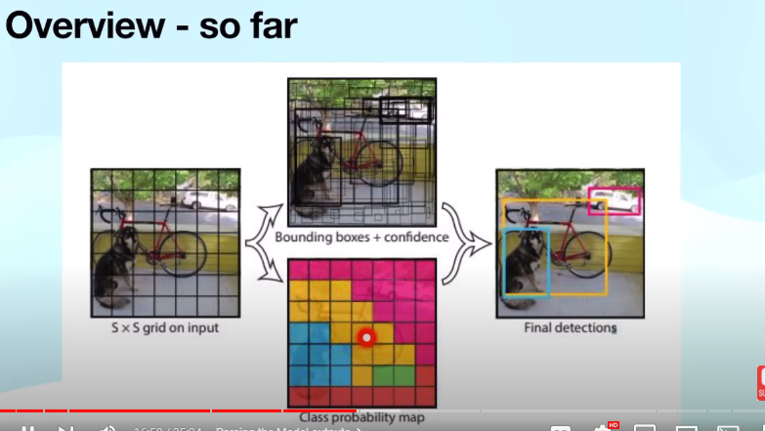
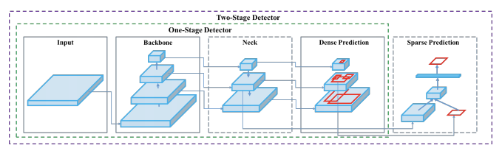
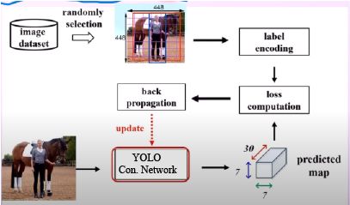
Flow chart
Recognition: Yolov4
Real-time object detection algorithm introduced in 2015
Known for its speed, accuracy, good generalization, and open-source nature.
YOLO processes images at high Frames Per Second (FPS) and has high mean Average Precision (mAP) compared to other real-time systems.
real-time object detection algorithm introduced in 2015.
“Tomato Harvesting using Machine Learning for Detection”

Slide 13
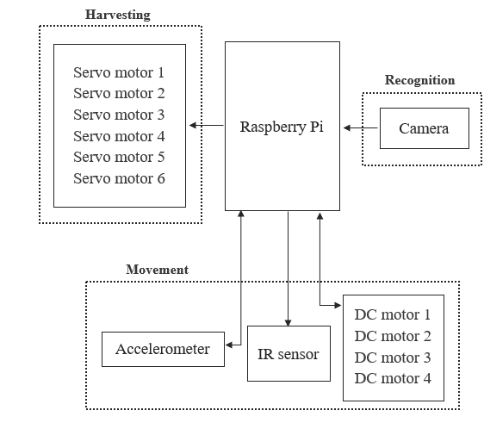
Block diagram
“Tomato Harvesting using Machine Learning for Detection”

Slide 14
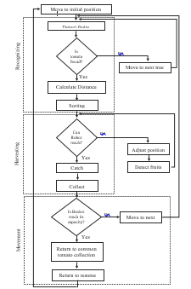
Flow chart
“Tomato Harvesting using Machine Learning for Detection”

Slide 15
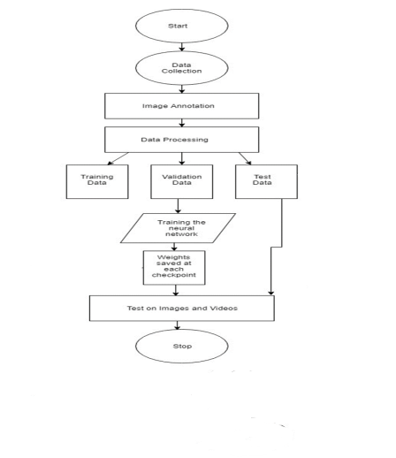
Flow chart
Detection flowchart
“Tomato Harvesting using Machine Learning for Detection”

Slide 16
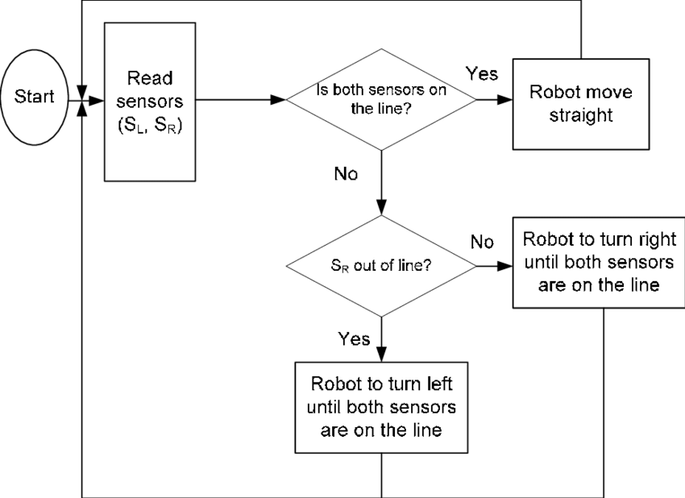
Flow chart
Movement
“Tomato Harvesting using Machine Learning for Detection”

Slide 17
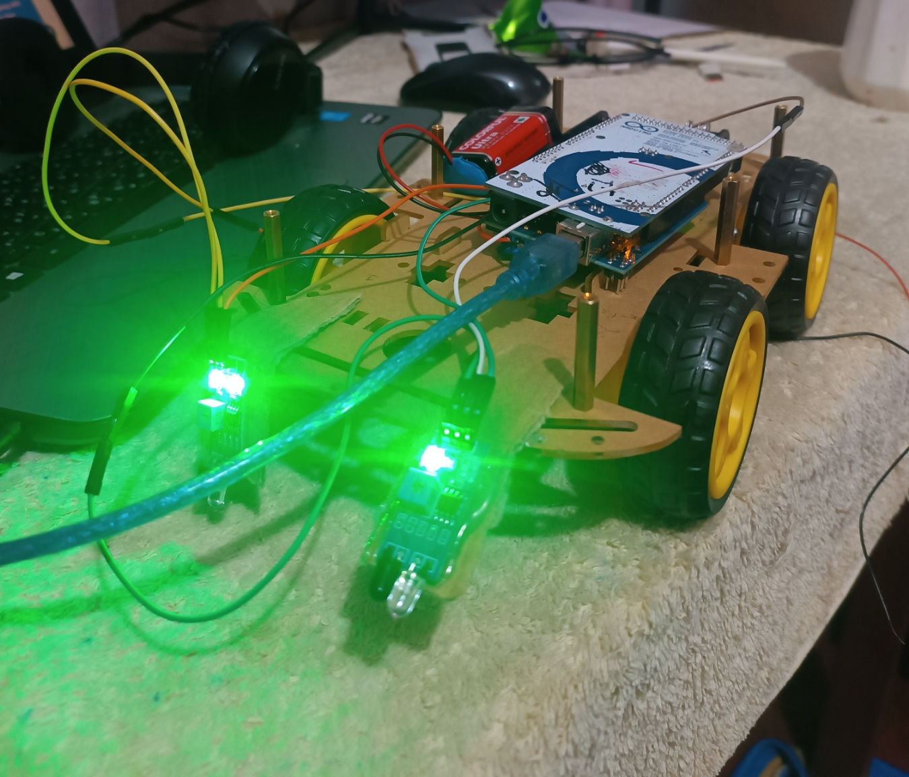
Workdone:
Hardware works:Movment
As our Project Vision is for harvesting. Till now for the hardware works we successfully able to install for the movement parts. Using two IR sensor for the following the line and automate the movement.
Video1: Forward
Video2: Right trun
Video1: Left turn and stop
Hardware installation
“Tomato Harvesting using Machine Learning for Detection”

Slide 18
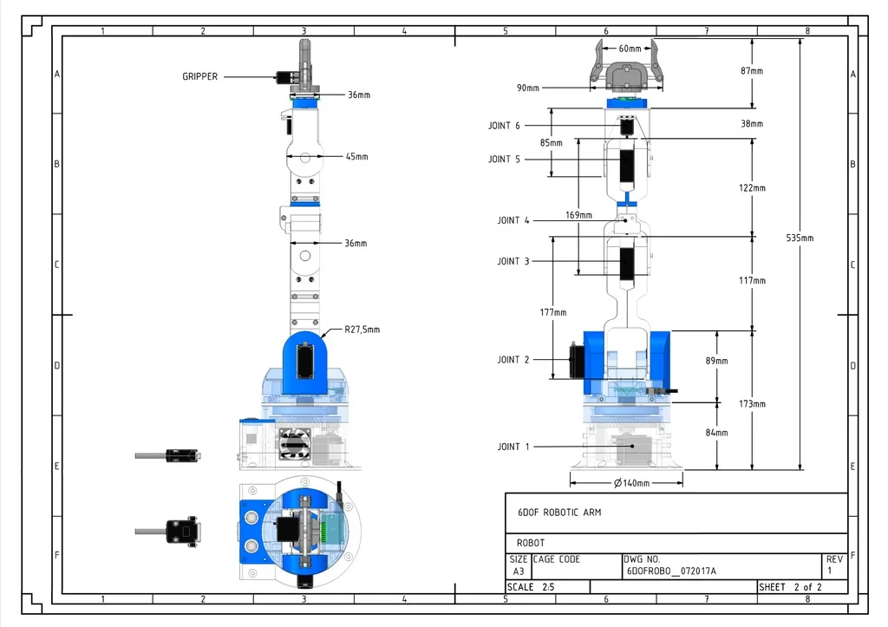
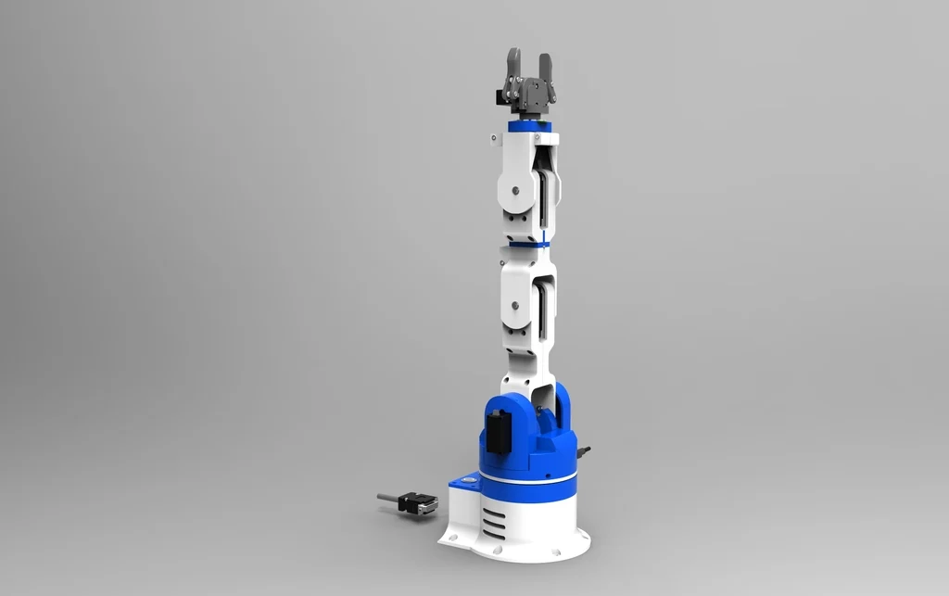
Workdone:
Hardware works: Ron=bot Arm selection
“Tomato Harvesting using Machine Learning for Detection”

Slide 19
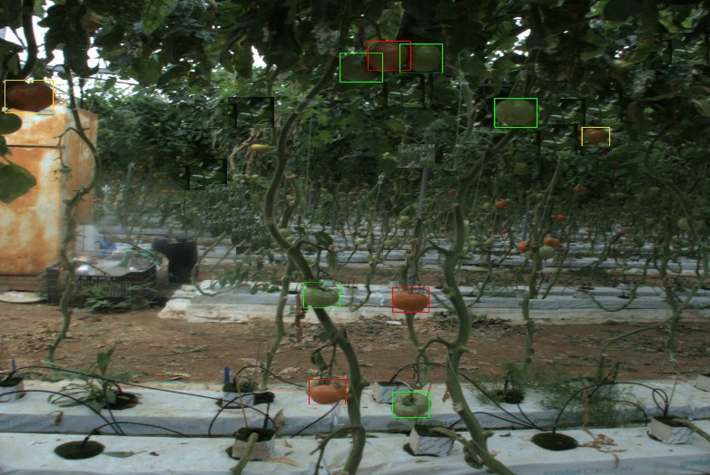
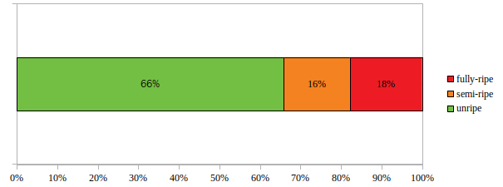
Workdone:
Software works:
Dataset preparation
Dataset Creation
Dataset it consists of 277 images with 2418 annotated tomato fruit samples of unripe, semi-ripe and fully-ripe classes.
Data organization
80%/20% train-test split ratio.
 | Train | Test
Images | 222 | 55
Annotated Boxes | 1952 | 466
Statistics and data analysis
Tomato classes
Unripe | Semi-Ripe | Fully-Ripe
1592 | 395 | 431
“Tomato Harvesting using Machine Learning for Detection”

Slide 20
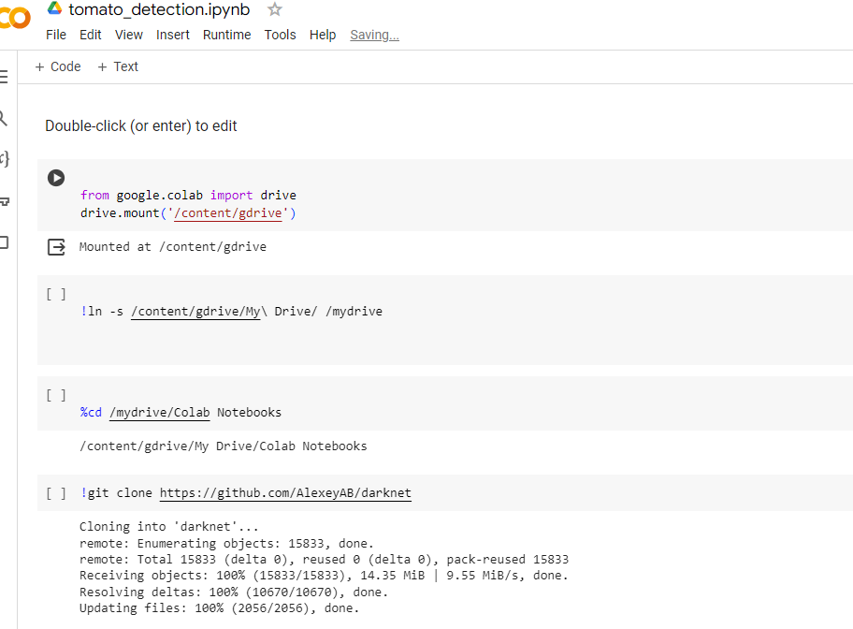
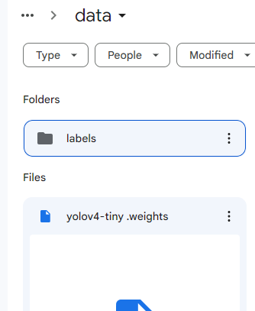
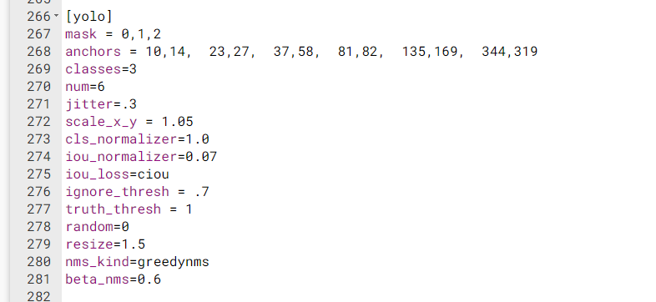
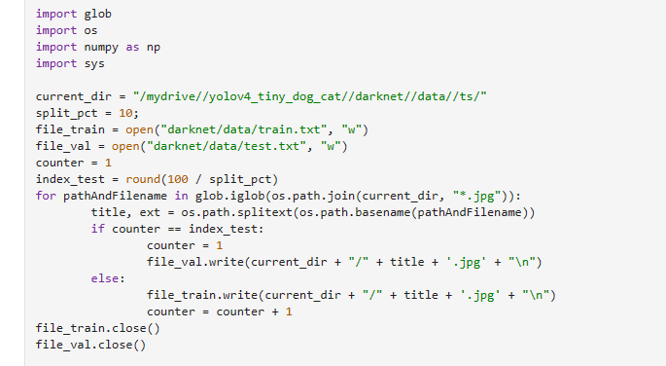
Snip of working of progress of yolo-v4-tiny For tomato detection
1. Cloning the yolo-v4 Darknet framework
3.Working over data train and test data on data folder
2.Modifing yolov4-tiny-custom.cfg based on our tomato class that is 3.
4. Till working on is training the dataset and giving the right weight
“Tomato Harvesting using Machine Learning for Detection”

Slide 21
Thank you

